Slide 1

Multilayer films
A quick dive into the theory

Slide 2
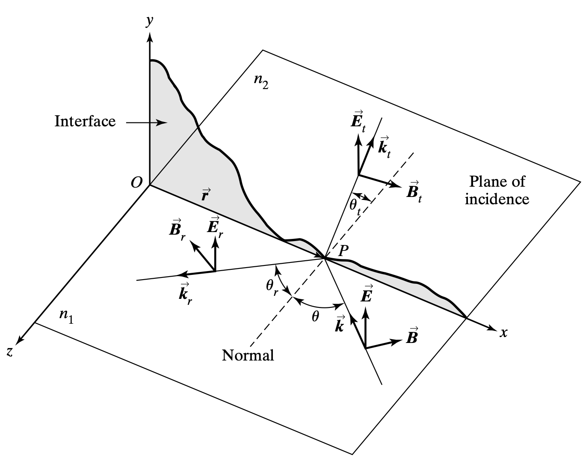
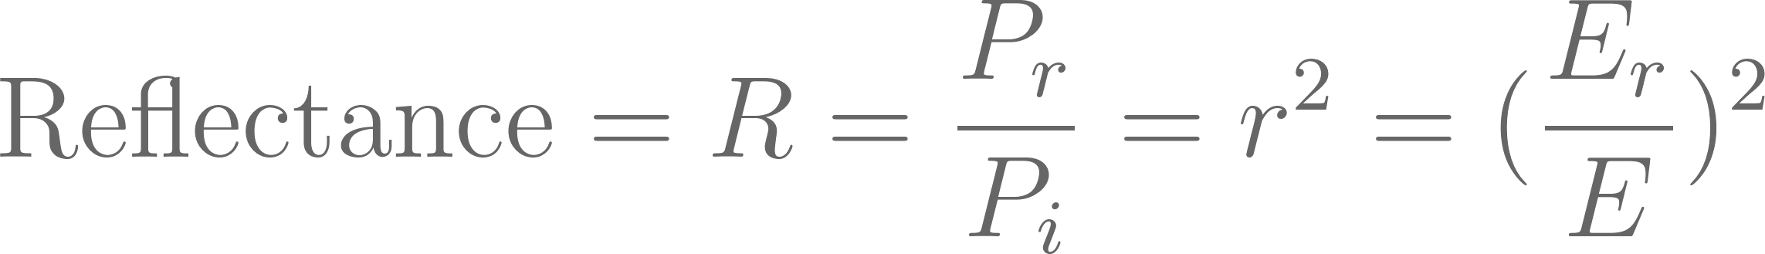
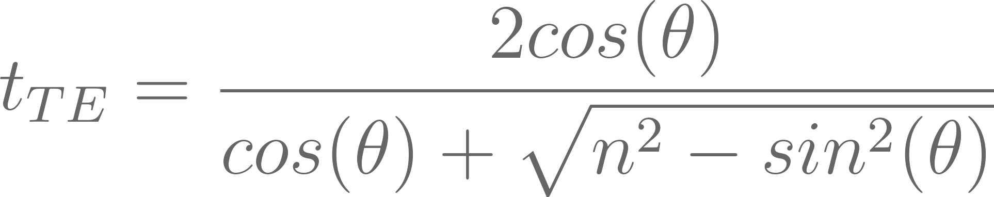
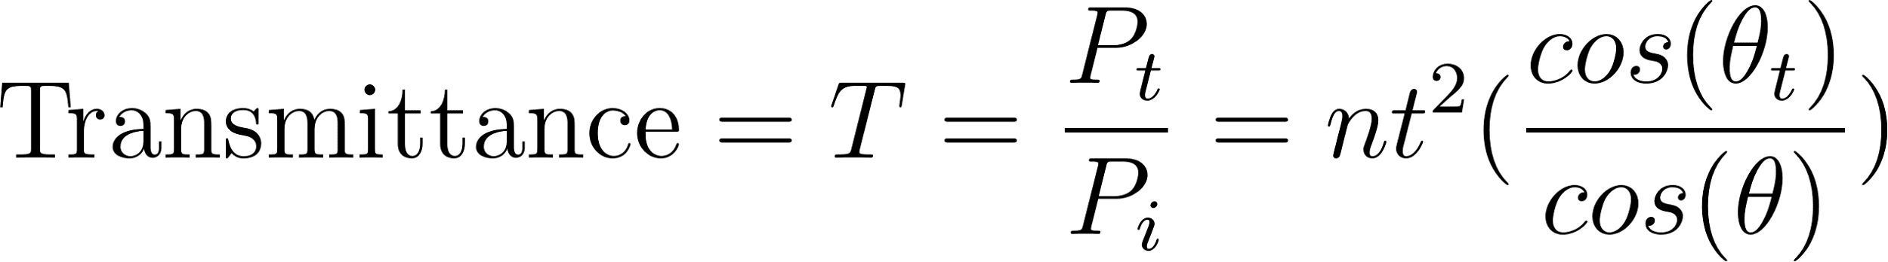
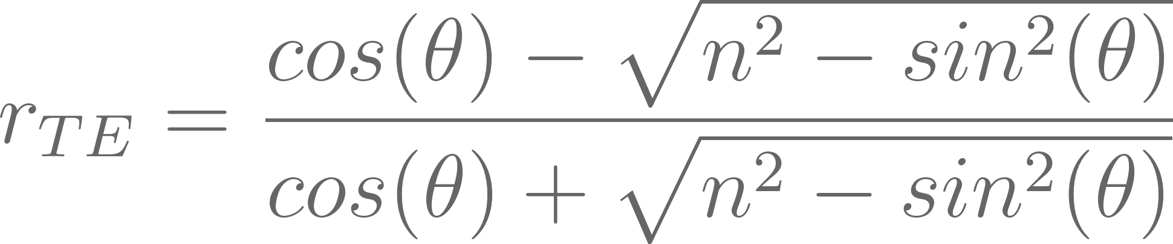
Recap
Question: In a basic linearly polarized electromagnetic wave model, can we derive equations to quantify the reflection and transmission of the incident wave in terms of irradiance?
Answer: The Fresnel Equations.

Slide 3
The Transfer Matrix

